Slide 1
MarineNet Moodle Account Creation

Slide 2
Already have a MarineNet Account? Do you know your username and password?

Slide 3
MarineNet Helpdesk: 1-888-435-8762 > MarineNet Account

Slide 4
For Those Creating New Account

Slide 5
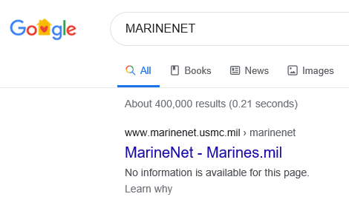
Open your browser
Type in MARINENET into the search box and click on the first option

Slide 6
Warning Statement

Slide 7
CAUTION:
After creating your account, you will need to REMEMBER what your USERNAME and PASSWORD is. Your username will be automatically created for you and will show on the following pages that you will need to fill out for the account request.
**Without your username, you will not be able to log into your account.**

Slide 9
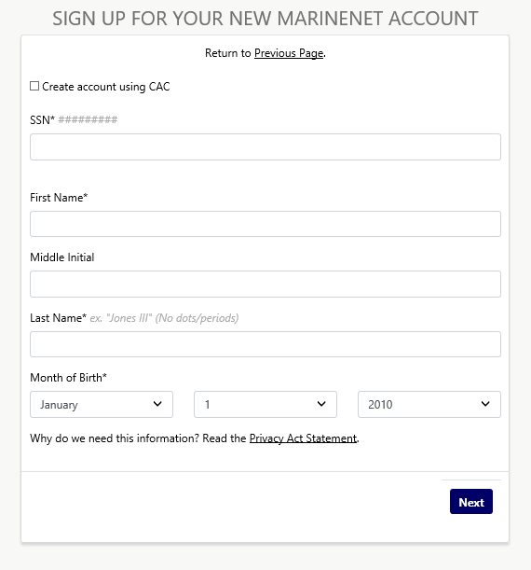
Do not select this box!

Slide 10
#########
John
A
Smith
1990

Slide 11
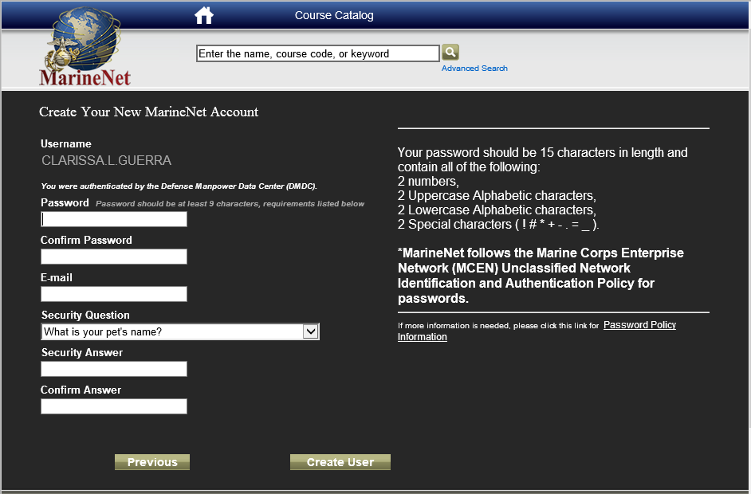
Username and Password
USERNAME is automatically generated here
Use your personal email address

Slide 12
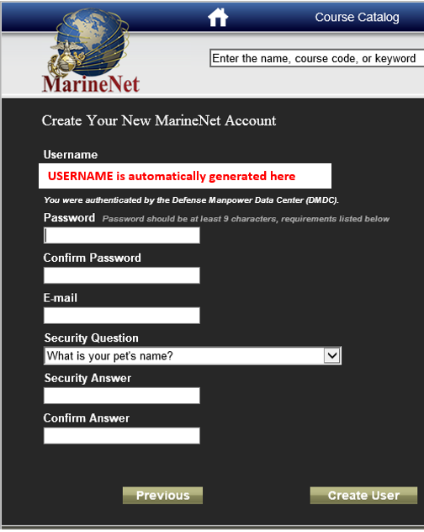
Password must be a minimum of 15 characters long
There are specific items that are required for each password.
Verify you are meeting the character requirements if you are having problems creating it.
Once you have created your password click “Create User”
Use your personal email address

Slide 13
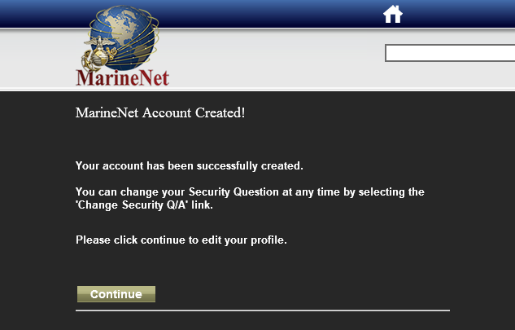

Slide 14
john.a.smith
??????????????
Verify that you can log in to your account.

Slide 15
All students will enroll into the Moodle course the first week of class.

